Slide 1
Video game Sales presentation
By johnny qiu

Slide 2
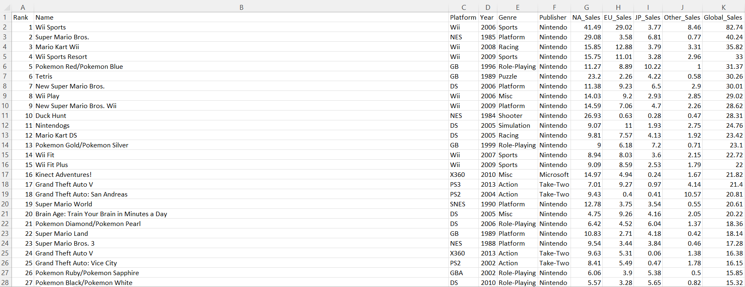
Video game sales dataset snippet

Slide 3
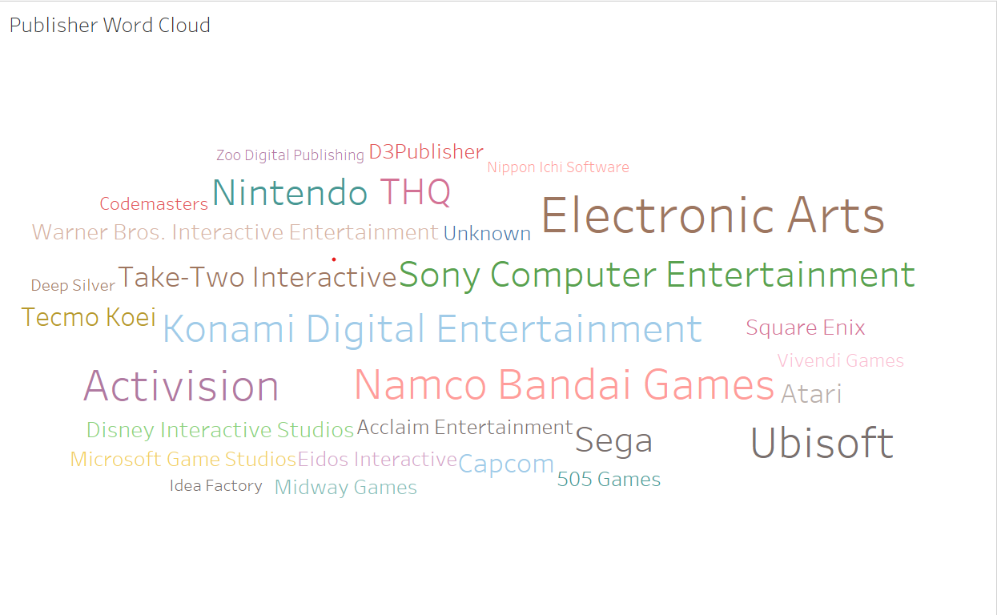
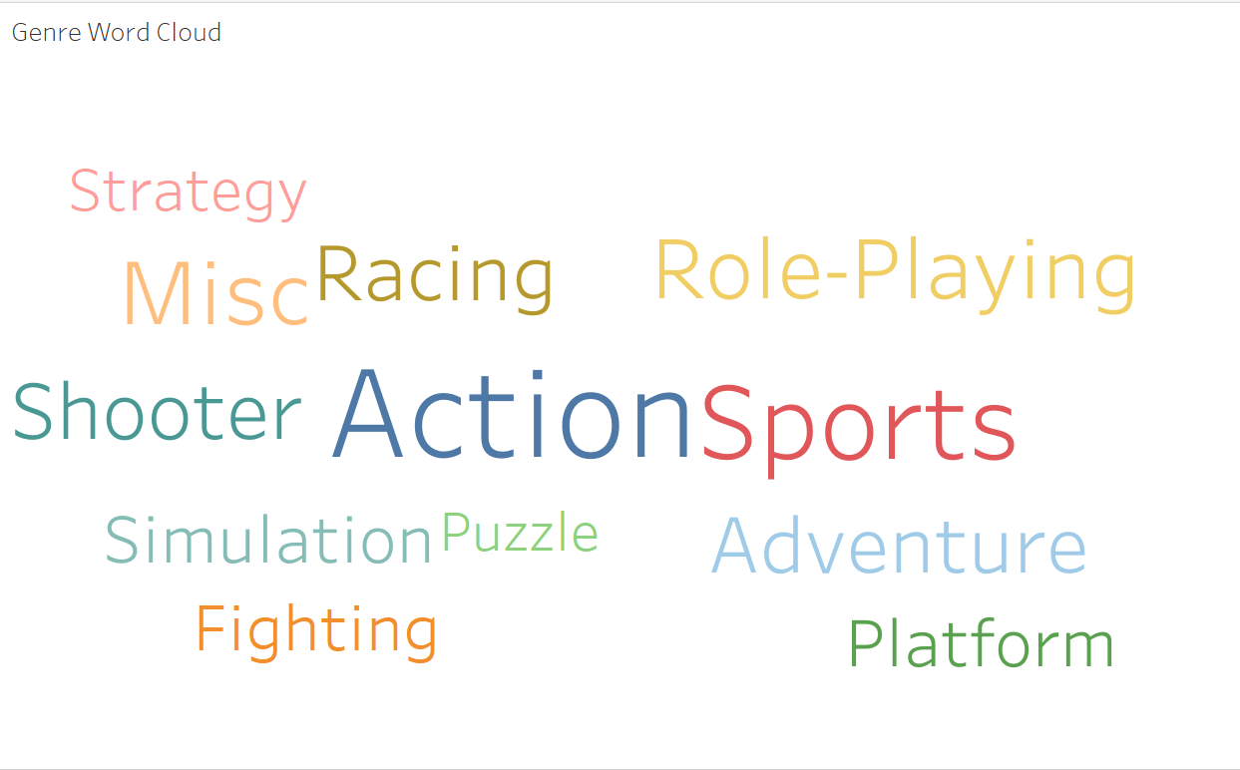
Word cloud

Slide 4
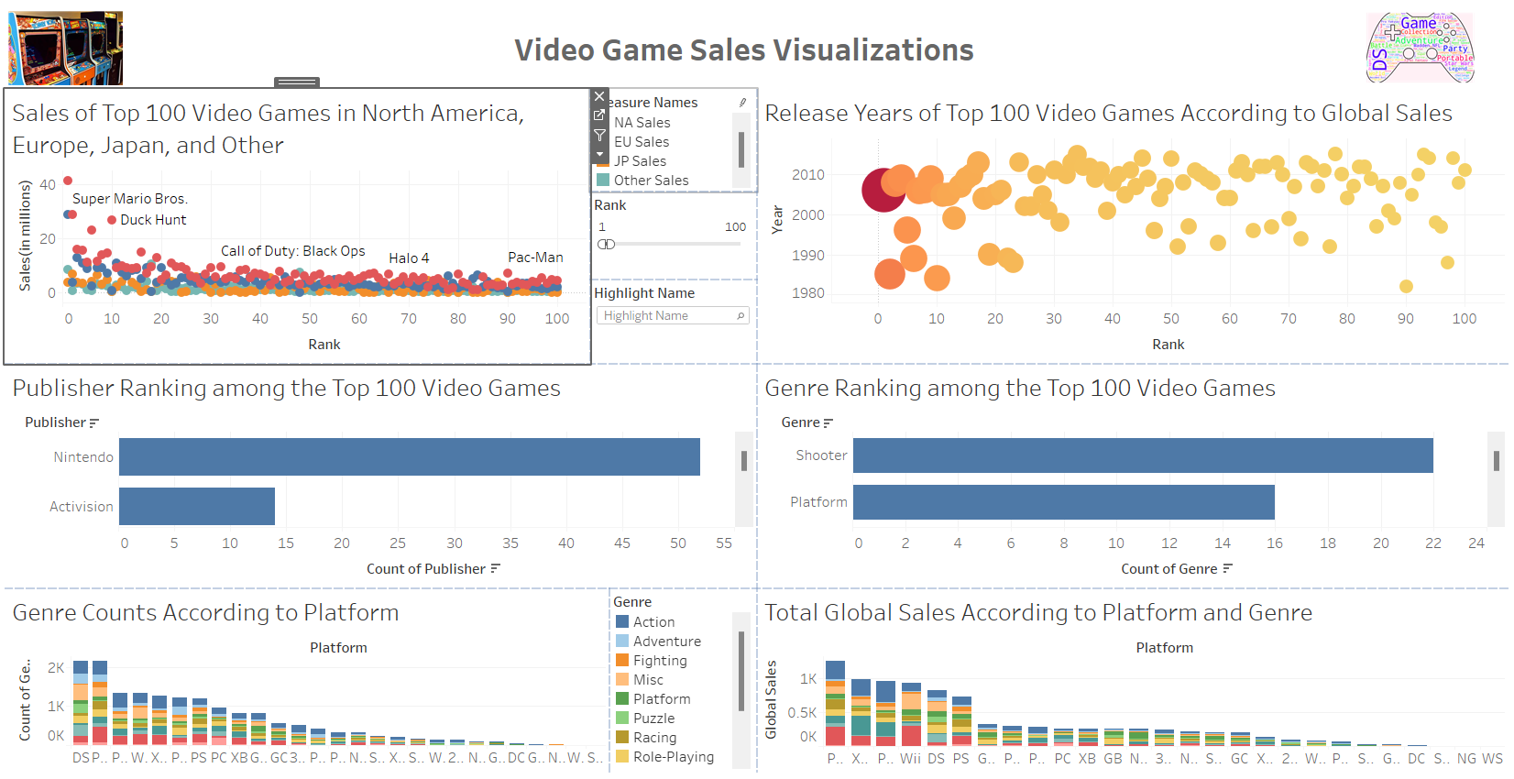
Final product

Slide 5
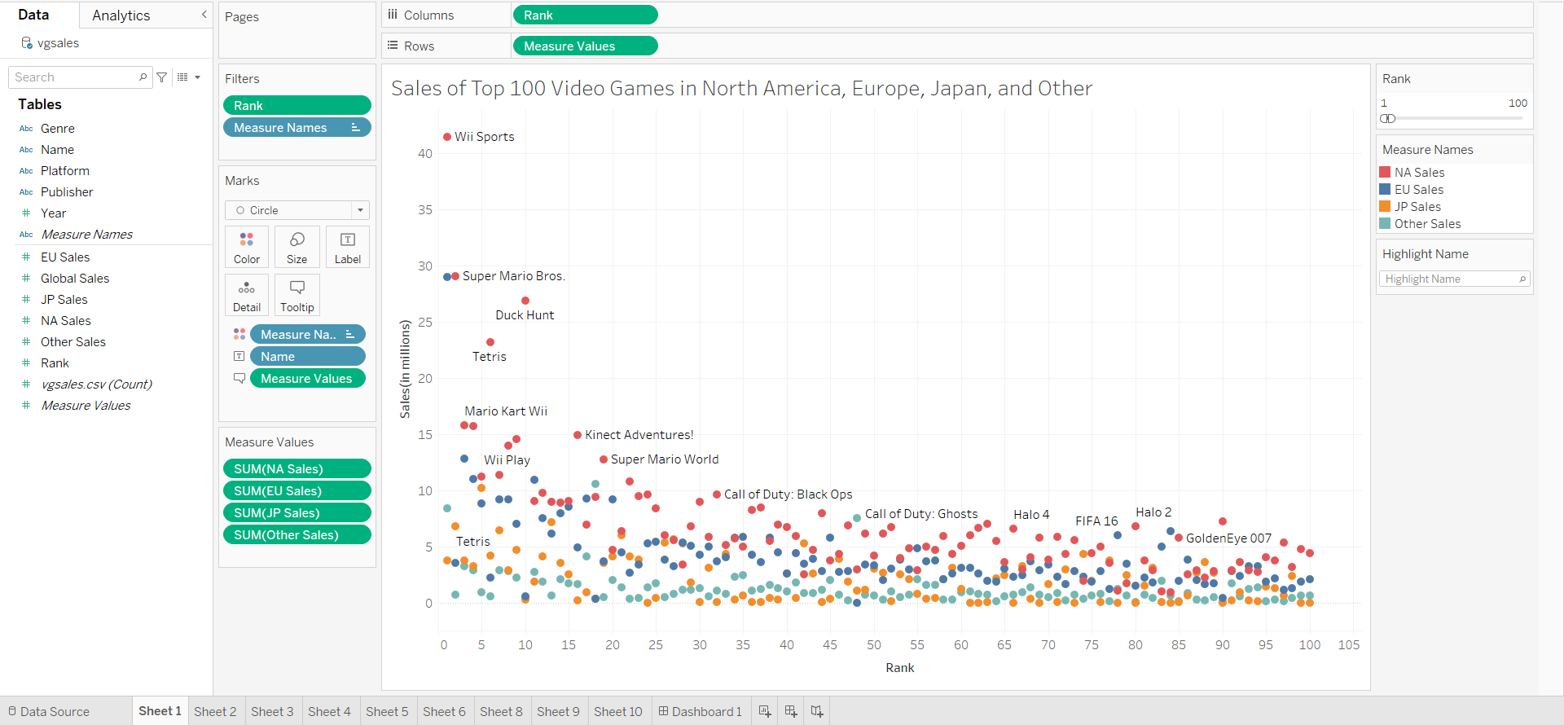
Graph 1
Notes:
Observations: mostly red dots on top, NA sales more than other regions. Second is EU sales.
Talk about Wii Sports: This game is a collection of five sports simulations, tennis, baseball, bowling, golf and boxing. The motion-sensing capabilities of the Wii Remote
Mario, pokemon etc.

Slide 6
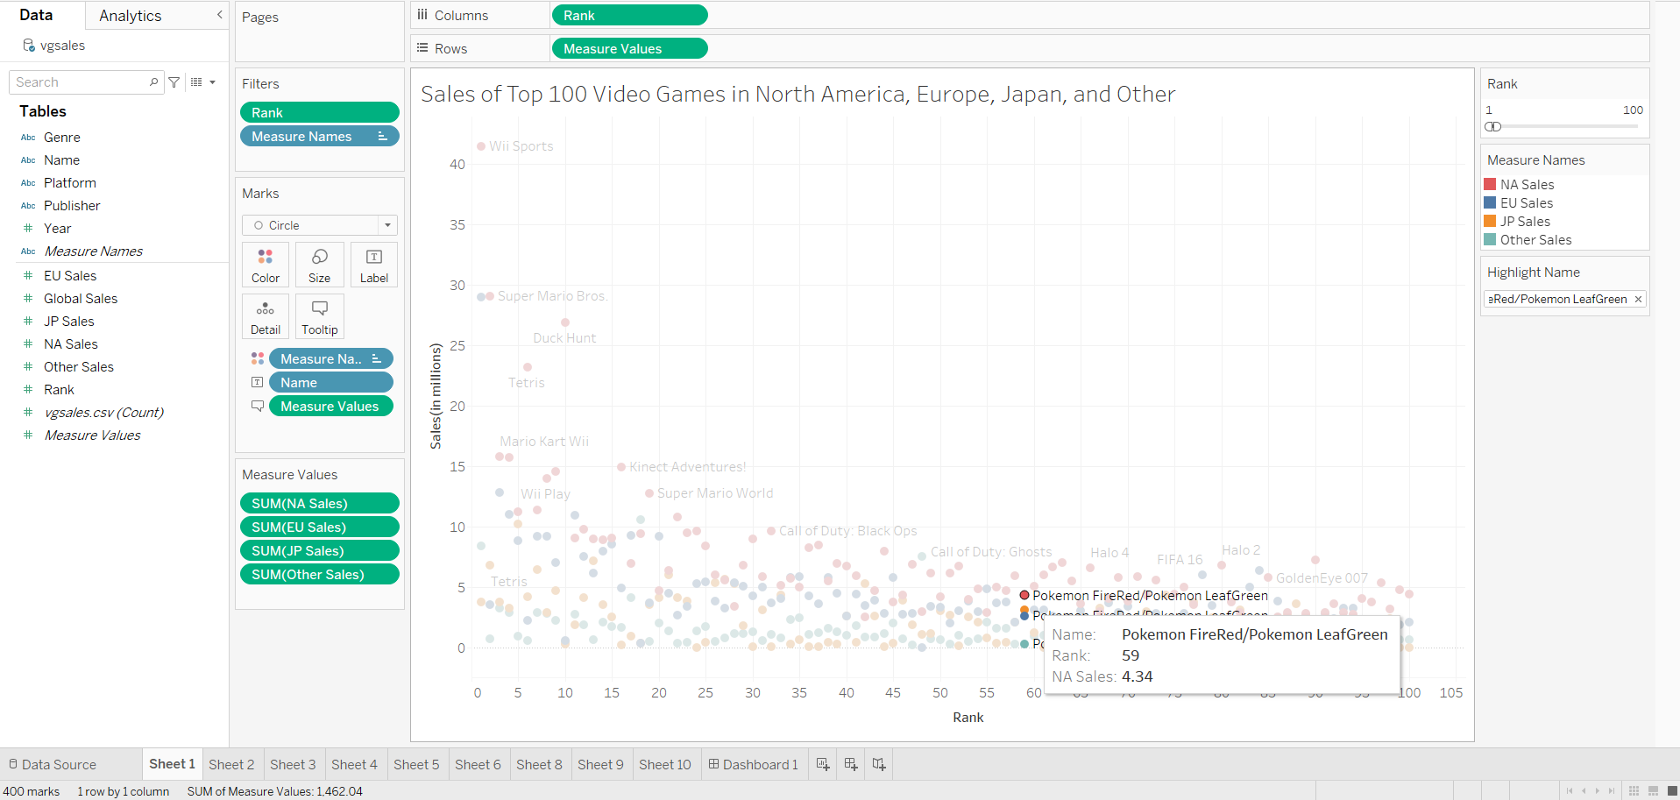
Interactivity: highlighting
Notes:
Particular game: FireRed

Slide 7
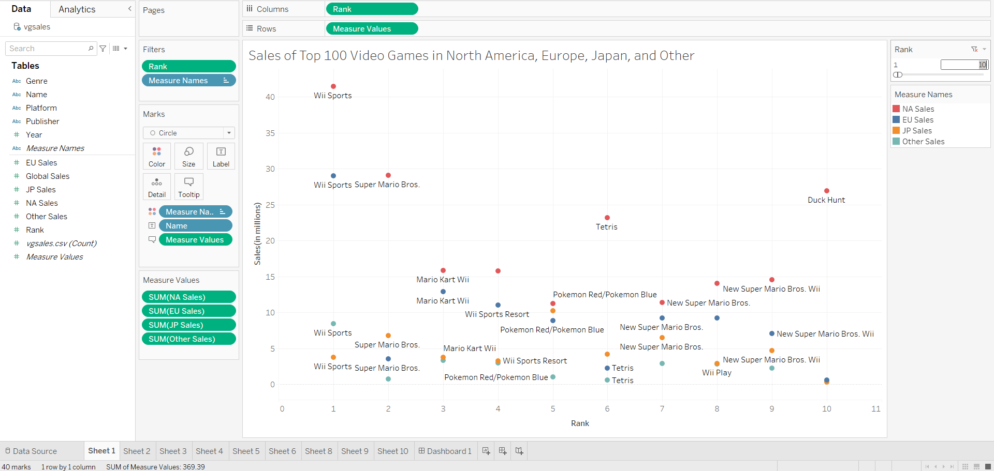
Interactivity: rank slider
Notes:
Top 10 video game sales

Slide 8
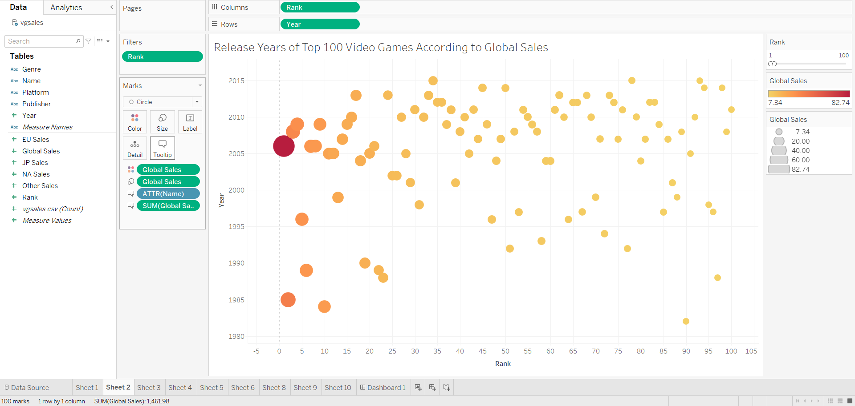
Graph 2
Notes:
Color and size according to global sales
Observation: some of the most popular games are made in 2005-2010. cluster of data

Slide 9
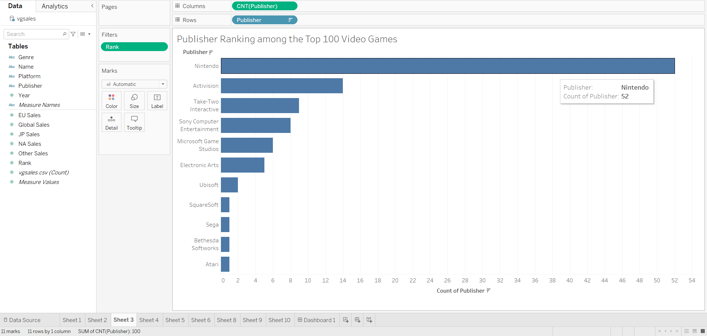
Graph 3
Notes:
Nintendo

Slide 10
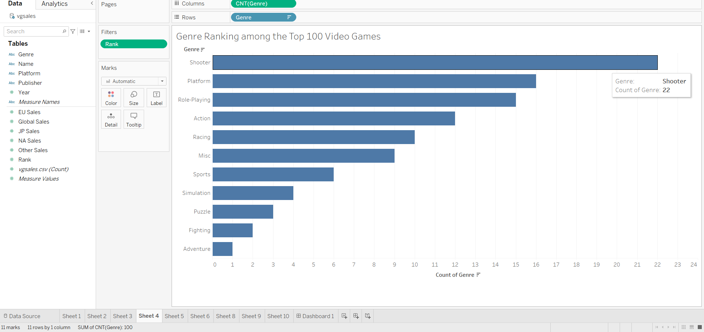
Graph 4
Notes:
Call of Duty

Slide 11
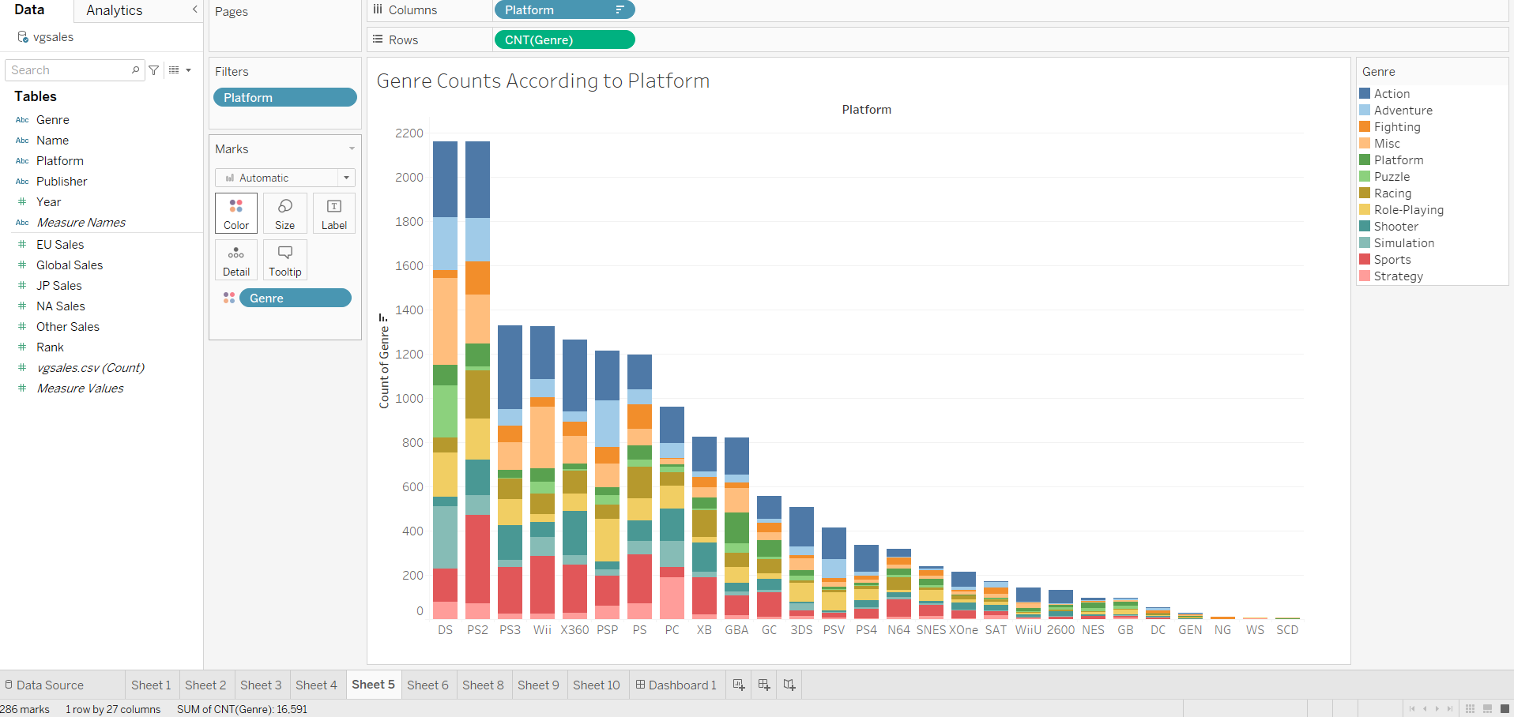
Graph 5
Notes:
Genre are color coded. Popular genres: action, sports, misc

Slide 12
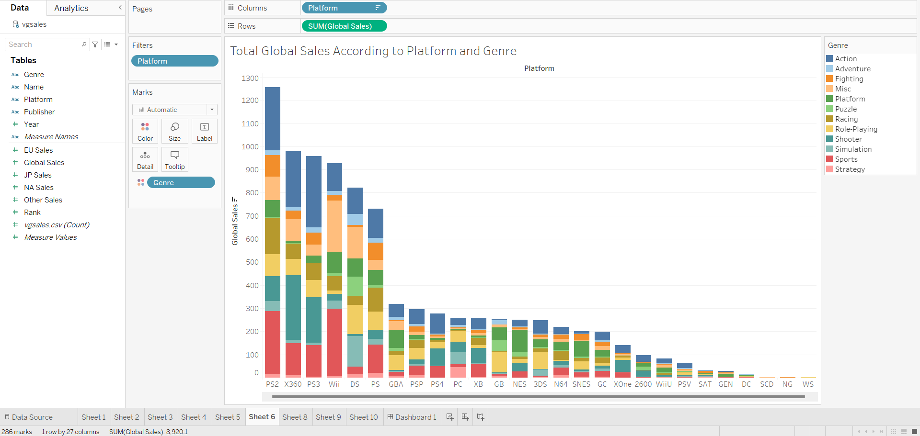
Graph 6
Notes:
Like last graph. Now it’s based on global sales.
PS2 most global sales

Slide 13
Final product

Slide 14
The end

